Slide 1
HOSPITAL MANAGEMENT
ANALYSIS
Transforming Hospital Data into Meaningful Insights
PRESENTED BY
PROJECT DOMAIN:
JENIFER.S
HOSPITAL DATA ANALYTICS

Slide 2
OUR PROJECT JOURNEY
From Hospital Data to Meaningful Insights
01
INTRODUCTION
05
TECHNOLOGY BEHIND IT
02
WHY THIS PROJECT?
06
THE LOGIC & VALIDATION
03
THE CHALLENGE
07
THE DASHBOARD OVERVIEW
04
DATA ANALYSIS PROCESS
08
KEY FINDINGS

Slide 3
01
INTRODUCTION
Raw data is like crude oil;
it becomes valuable only when it is refined into meaningful insights
  Hospital generates large volumes of data.
  Data includes patients, doctors, pharmacy, laboratory and billing.
  Analysing raw data manually is time-consuming.
  Power BI helps convert data into meaningful visual insights.
  The project provides an interactive and centralized dashboard.

Slide 4

02
WHY THIS PROJECT?
  Huge amount of hospital data
  Manual reports are slow and error-prone
  Need for data-driven decisions
  Interactive dashboards improve efficiency

Slide 5

03
THE CHALLENGE
  Large amount of hospital data
  Time-consuming manual analysis
  Difficulty in identifying trends
  Need for centralized reporting

Slide 6

04
DATA ANALYSIS PROCESS
Step 1
Step 3
Step 5
Microsoft Excel
MySQL Workbench
Figma
Step 2
Step 4
CSV
Powerbi

Slide 7

05
TECHNOLOGY BEHIND IT
  Microsoft Excel - Data preparation
  CSV - Data format and transfer
  MySQL Workbench - Data import and storage
  Power BI - Data analysis and visualization
  Figma - UI and dashboard design

Slide 8

06
LOGIC & VALIDATION
Key Performance Indicators
LOGICAL THINKING
  Grouped related information
  Organized data by hospital areas
  Simplified navigation
  Designed for easy analysis
TESTING
  Verified data accuracy
  Checked visuals and KPIs
  Tested filters and slicers
  Tested navigation and page transitions

Slide 9

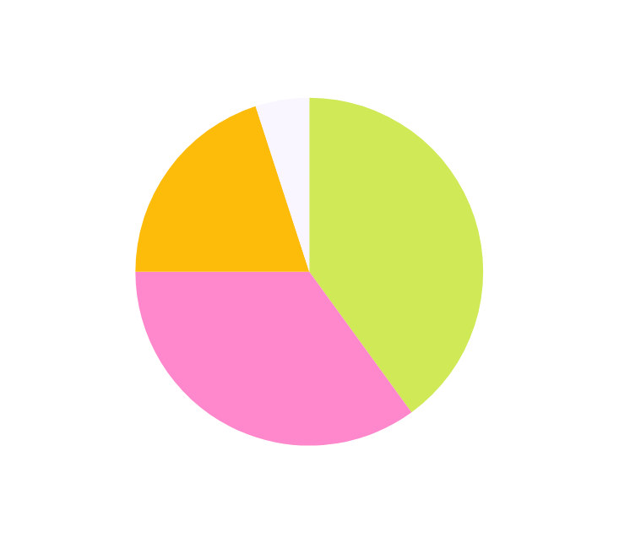
07
DASHBOARD OVERVIEW
01
02
03
MONTHLY ANALYTICS REPORT
REVENUE BREAKDOWN
PATIENT BEHAVIOR ANALYSIS
  Key Performance Indicators
  Monthly Trends
  Revenue Analysis
  Performance Comparison
  Revenue Distribution
  Department-wise Performance
  Revenue Contribution
  Trend Analysis
  Patient Demographics
  Patient Payment mode
  Treatment Trends
  Interactive Analysis

Slide 10

BACKGROUND DESIGN USING FIGMA

Slide 11
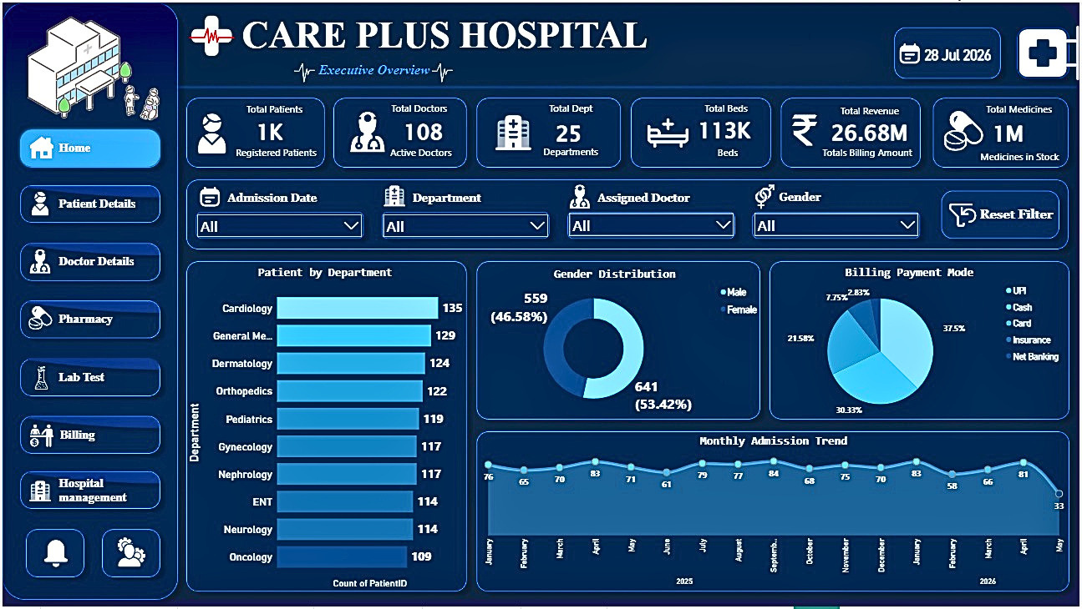
HOME PAGE

Slide 12
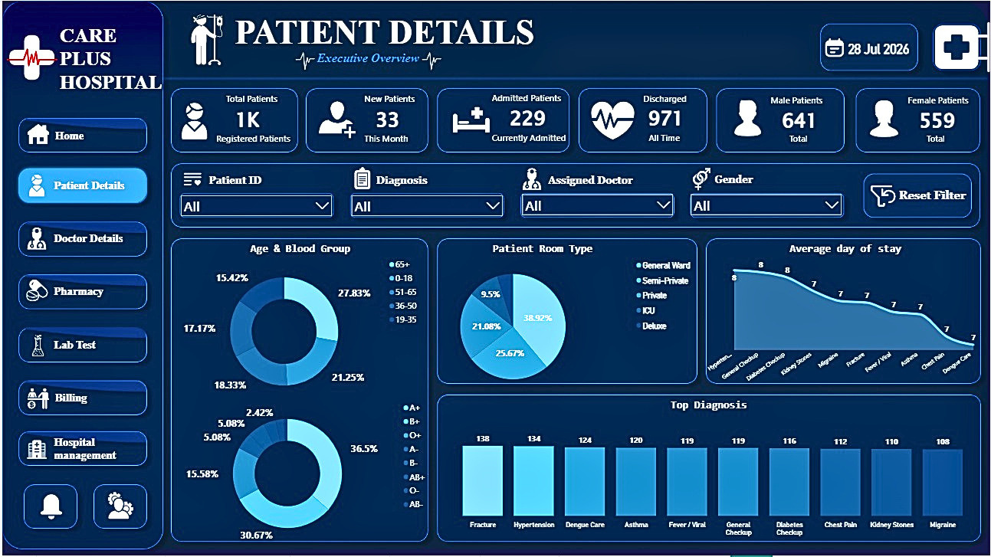
PATIENT PAGE

Slide 13
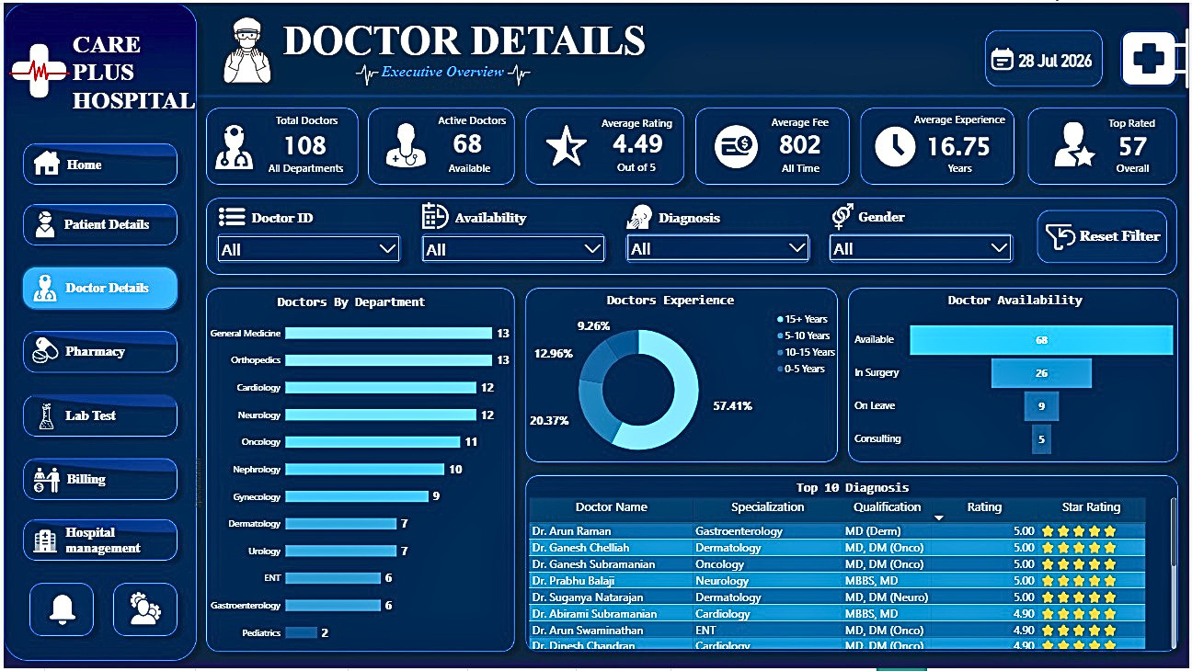
DOCTOR PAGE

Slide 14
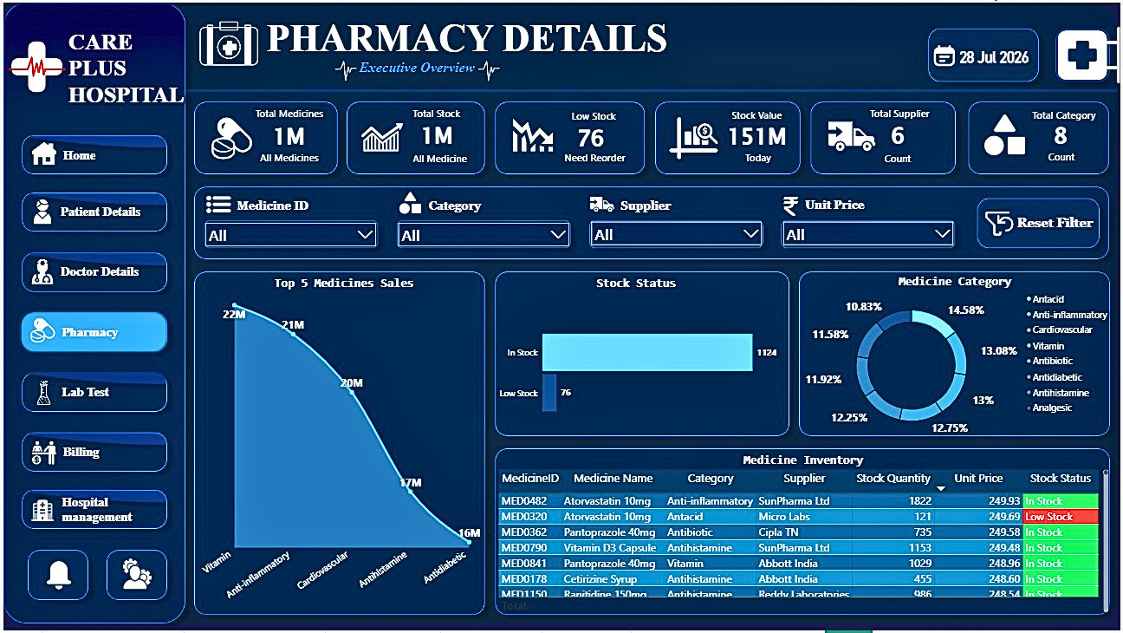
PHARMACY PAGE

Slide 15
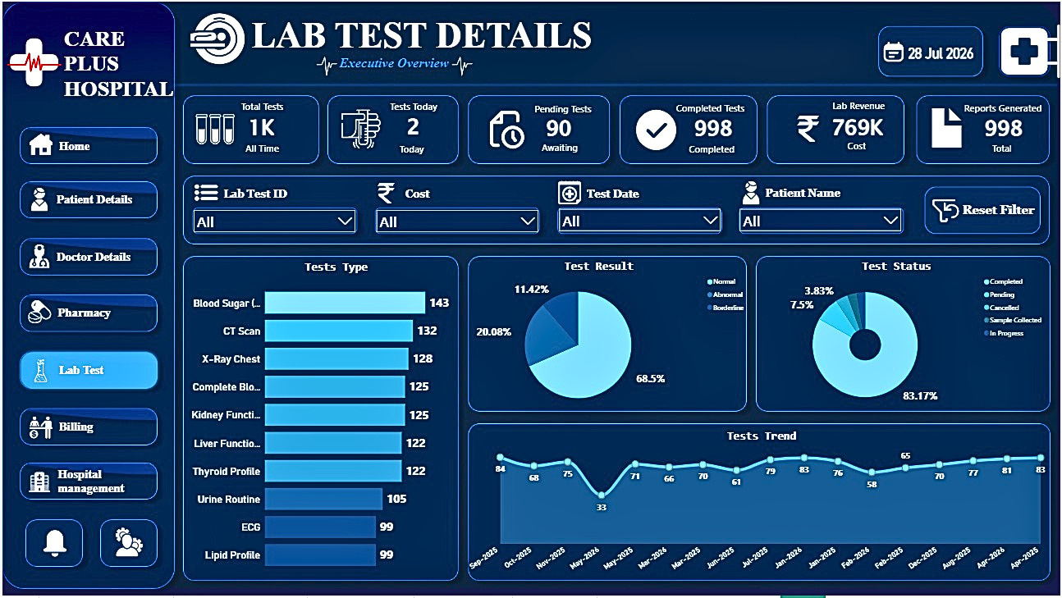
LAB TEST PAGE

Slide 16
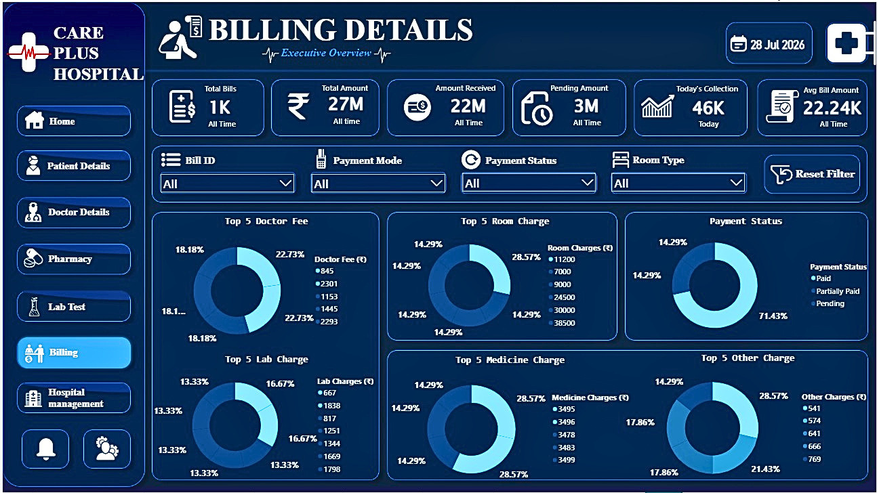
BILLING PAGE

Slide 17
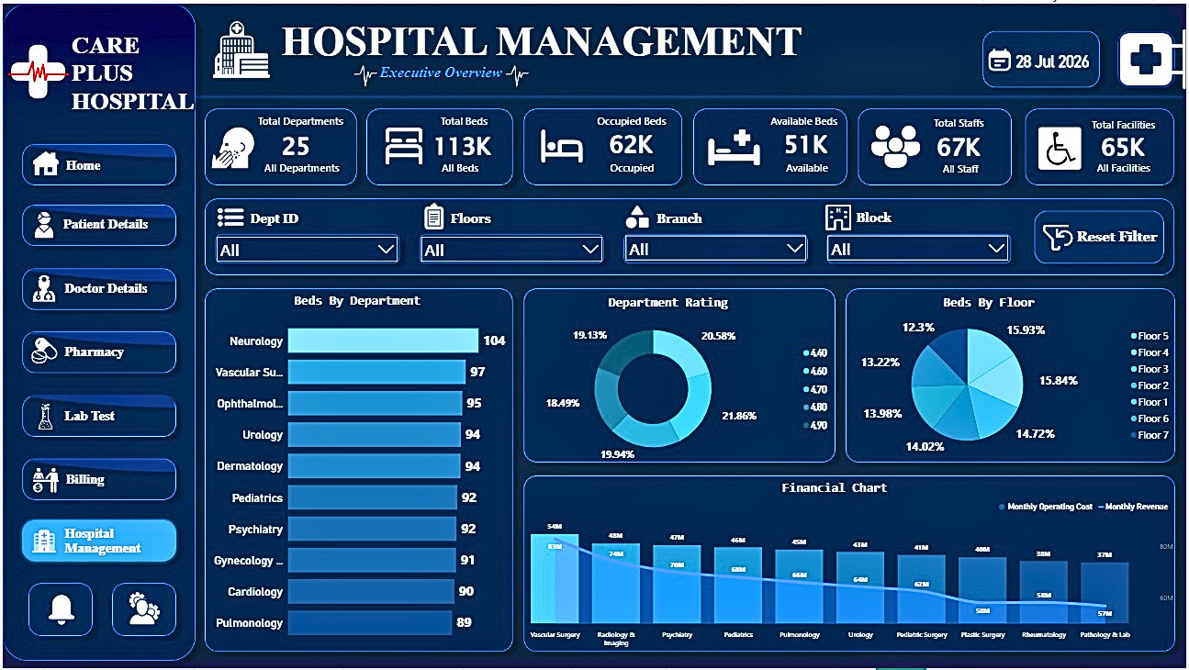
MANAGEMENT PAGE

Slide 18
08
KEY FINDINGS
PROJECT IMPACT
FUTURE SCOPE
  Faster Decision-Making
  Time Saving
  Better Reporting
  Interactive Insights
  Improved Efficiency
  Real-Time Data Integration
  AI-Based Prediction
  Cloud Deployment
  Mobile Dashboard
  Advanced Analytics

Slide 19

CONCLUSION
  Successfully developed an interactive Power BI dashboard.
  Converted raw hospital data into meaningful insights.
  Improved reporting and decision-making.
  Reduced manual analysis and increased efficiency.
  Demonstrated the value of data analytics in healthcare.

Slide 20
THANK YOU
Questions & Answers
GitHub Link: https://github.com/jenifersjeni568-star/Hospital-Management-Analysis/tree/main

